Slide 1
Elementary Data Structures
Chaklam Silpasuwanchai

Slide 2
Readings
Chapter 10-13, 18, Cormen et al. (2009). Introduction to Algorithms, Third Edition (3rd ed.). The MIT Press.
Chapter 3, Data Structures, Skiena, S. S. (2008). The Algorithm Design Manual, Second Edition (2nd ed.). Springer Science & Business Media.
Chapter 2, 4, 5, 8, 9, 10, 11, 12, 13, Robert Lafore. (2002.) Data Structures and Algorithms in Java, Second Edition (2nd ed.). Sams, Indianapolis, IN, USA.
Douglas Wilhelm Harder, Waterloo University - https://ece.uwaterloo.ca/~dwharder/aads/

Slide 3
Outline
Arrays
Linked List
Stacks
Queues
Binary Search Tree
Hash Tables

Slide 4
Elementary Data Structures
Elementary data structures are the “off-the-shelf” components we build our algorithm from.
Each data structures have
different operations
different performance
Key point: Know which data structures to use for which problem

Slide 5
Arrays
Fixed size data record
Located by its memory address
Constant time access, because it’s memory based
Contiguously allocated
allow the exploitation of high-speed cache memory on modern computer architectures
Limitations: fixed size

Slide 6
Arrays
 | Running time in BigO
Access | O(1)
Linear search | O(N)
Binary search in ordered array | O(log N)
Insertion at end | O(1)
Insertion at middle (requires shifting) | O(N)
Deletion at end | O(1)
Deletion at middle (requires shifting) | O(N)

Slide 7
Dynamic array
ArrayList in java with unlimited add() function
Double the size whenever the array is full
It takes time to copy the old contents to new array on each new expansion
The first inserted element needs to recopied log₂n times, when n is inserted
Limitations: unused space

Slide 8
Dynamic array
 | Running time in BigO
Access | O(1)
Linear search | O(N)
Binary search in ordered array | O(log N)
Insertion at end | O(1) + copy
Insertion at middle (requires shifting) | O(N) + copy
Deletion at end | O(1) + copy
Deletion at middle (requires shifting) | O(N) + copy

Slide 9

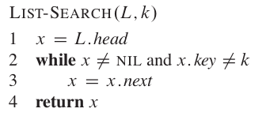
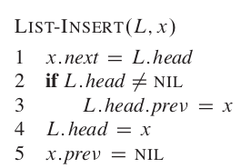
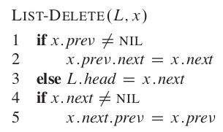
Linked List
Memory is a valuable resource
Instead of contiguous structure, used link
Thus, no expansion problem
Each linked list contains
The head pointer, pointing to the first node
The nodes in between
The last node
Each node contains two information, the item itself, and the pointer to the next node.
Limitations: access requires linear time

Slide 10
Linked List
 | Running time in BigO
Access | O(N)
Linear search | O(N)
Binary search in ordered linked list | O(N) (requires access to middle)
Insertion at end | O(1)
Insertion at middle (requires shifting) | O(1)
Deletion at end | O(1)
Deletion at middle (requires shifting) | O(1)

Slide 11
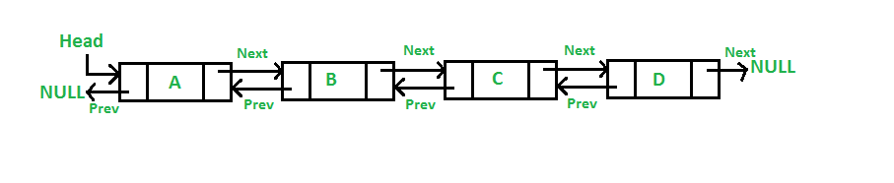
Doubly Linked List
Everything same as Linked List, but also stored the previous node
Can traverse forward or backward
Deletion is faster since we know the previous node
Limitations: extra memory space and maintenance for storing the previous

Slide 12
Doubly Linked List
 | Running time in BigO
Access | O(N/2) = O(N)
Linear search | O(N/2) = O(N)
Binary search in ordered array | O(N/2) = O(N)
Insertion at end | O(1)
Insertion at middle (requires shifting) | O(1)
Deletion at end | O(1)
Deletion at middle (requires shifting) | O(1)

Slide 13
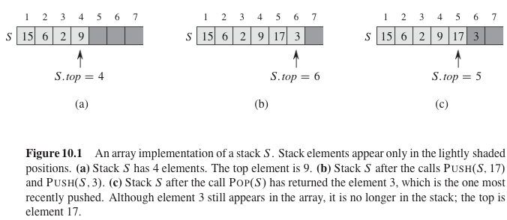
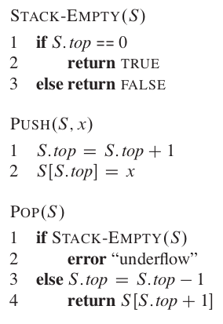
Stacks
Sometimes the order of which things get in and get out is important.
Stacks supports last in, first out operations:
Push (x, s) - insert item x on top of s
Pop (x, s) - remove the top item from top of s
When is Stacks being used?
To reverse a word
Undo mechanisms in text editors
Back button in browsers
Evaluating mathematical expressions
Parsing in compilers

Slide 14
Stacks
 | Running time in BigO
Access | O(N)
Linear search | O(N)
Binary search | Not possible
Insertion | O(1)
Deletion | O(1) if you are first, O(N) if you are last

Slide 15
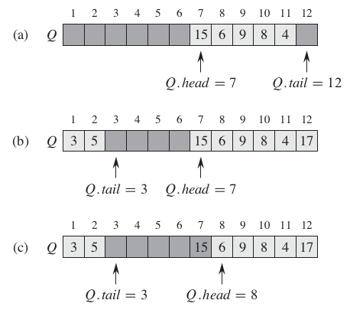
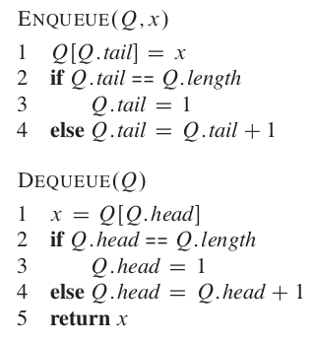
Queues
Queues supports first in, first out operations:
Enqueue (x, q) - insert item x at back of q
Dequeue (x, q) - remove x from front of q
When is queues being used?
Print queues
Web services
Any store queuing system
Task processings

Slide 16
Queues
 | Running time in BigO
Access | O(N)
Linear search | O(N)
Binary search | Not possible
Insertion | O(1)
Deletion | O(1) if you are first, O(N) if you are last

Slide 17
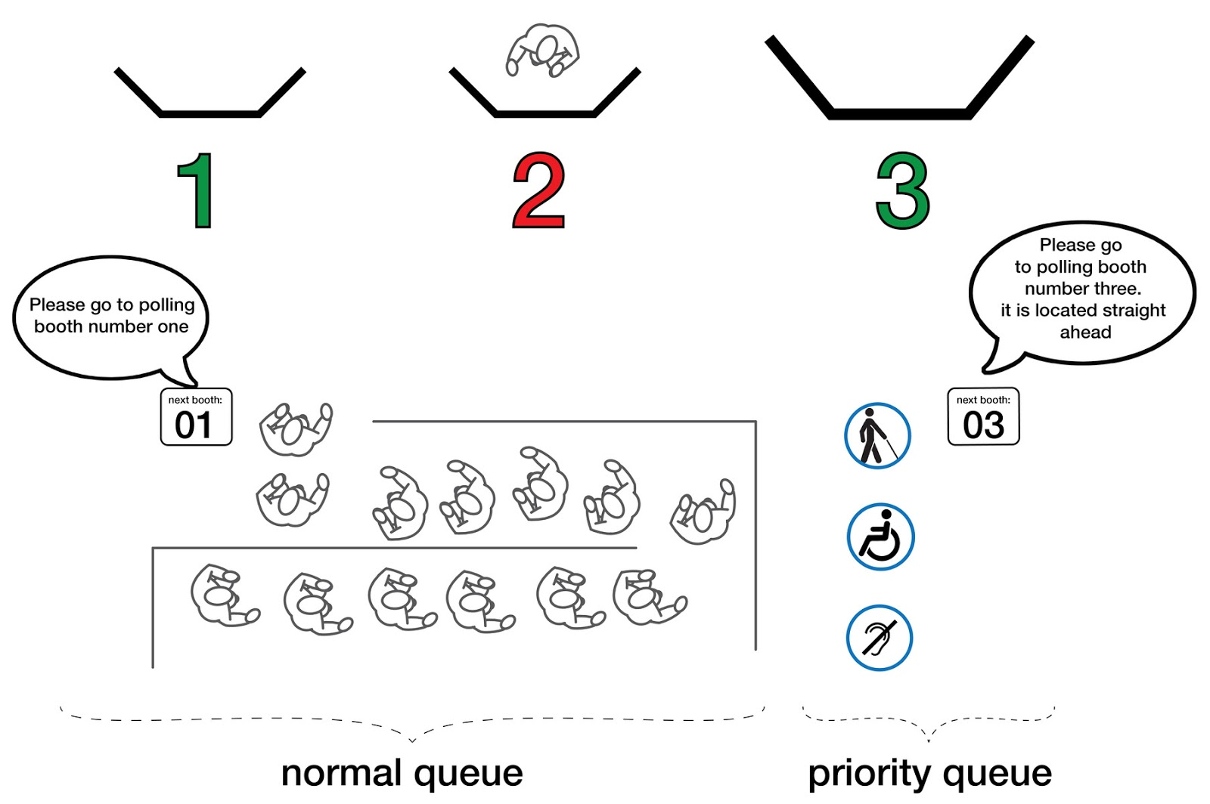
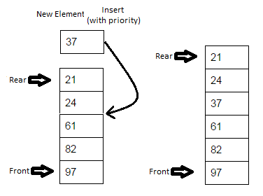
Priority Queues
Same with queues but allow us to store each item with priority level, commonly implemented using heap
Higher priority item will be served first before lower priority
If two items have the same priority, they will be served according to the order of the queue

Slide 18
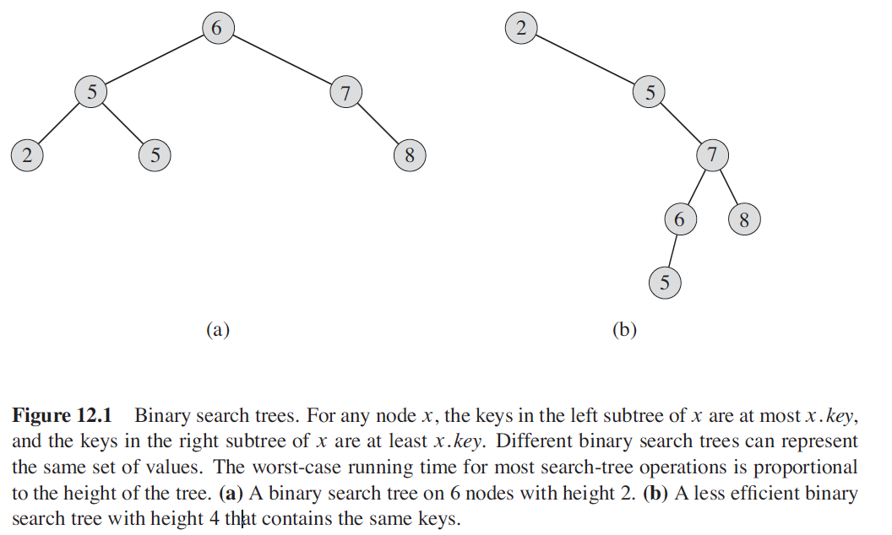
Binary Search Trees
A binary tree is a rooted tree where each node contains at most two children.
Each child can be identified as either a left or right child
In addition to a key and satellite data, each node contains attributes left, right, and p that point to the nodes corresponding to its left child, right child, and parent
If a child or the parent is missing, the appropriate attribute contains the value NIL.
Let x be a node in a binary search tree. If y is a node in the left subtree of x, then y.key ≤ x.key. If y is a node in the right subtree of x, then y.key ≥ x.key.

Slide 19
Demo

Slide 20
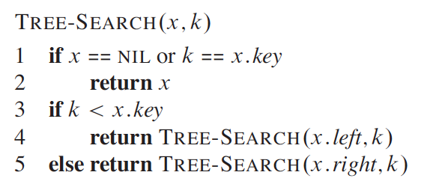
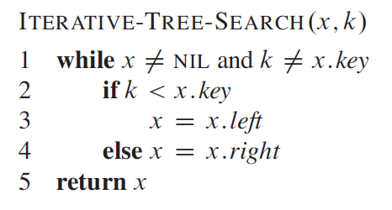
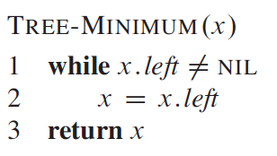
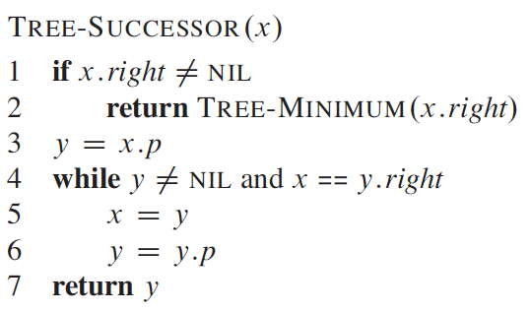
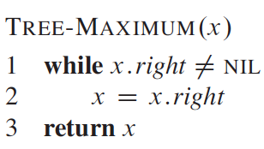
Binary search trees - search, min, max, successor
If all keys are distinct, successor of a node x is the node with the smallest key greater than key[x]

Slide 21
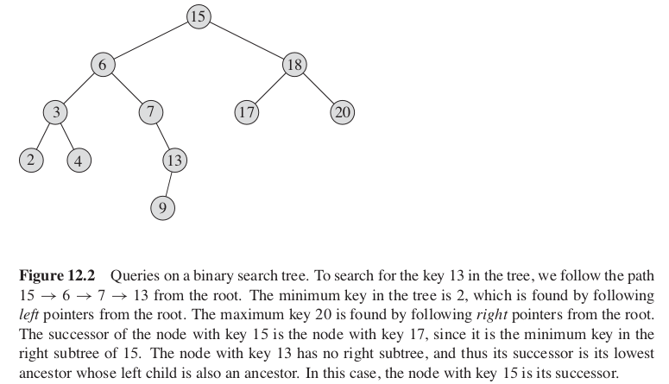
Binary search trees - search, min, max, successor

Slide 22
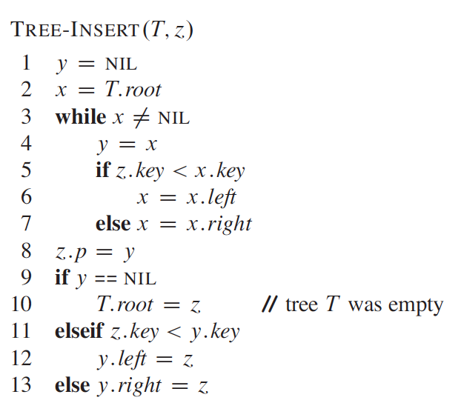
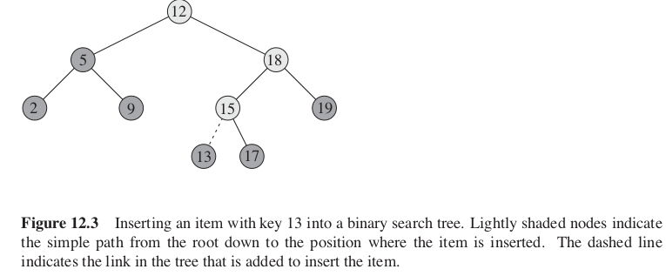
Binary Search Trees

Slide 23
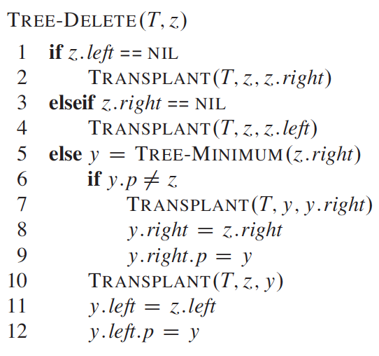
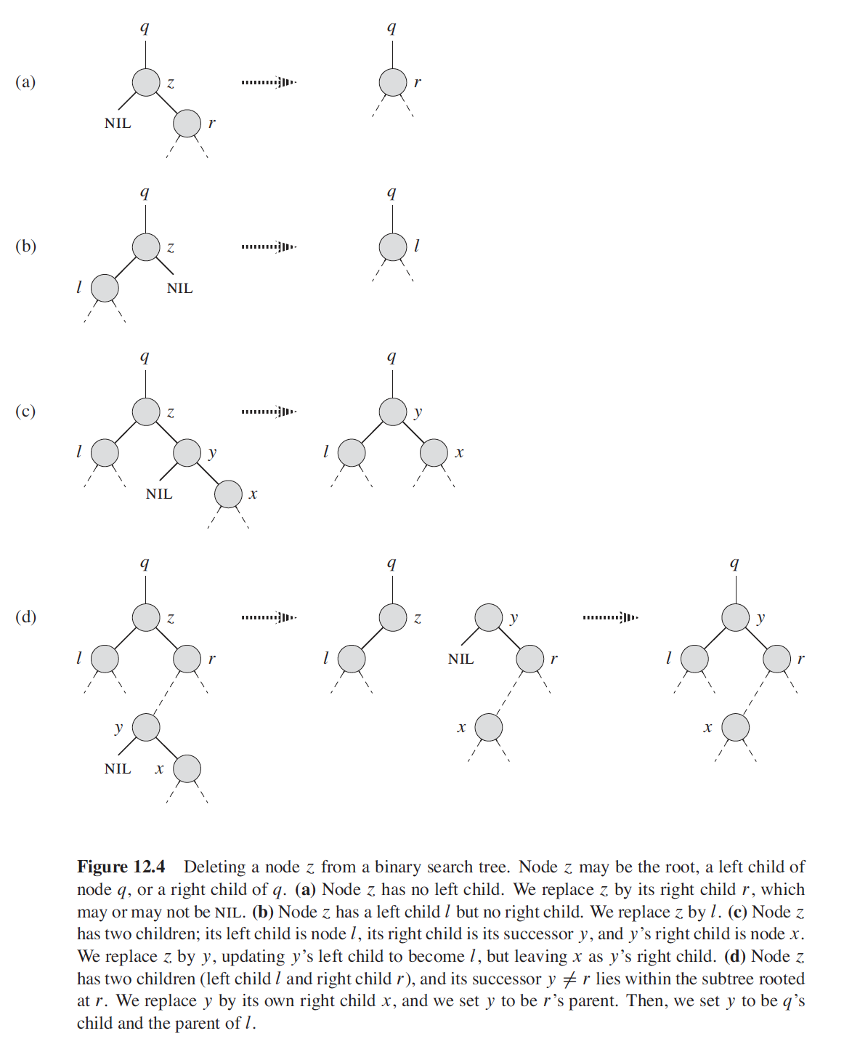
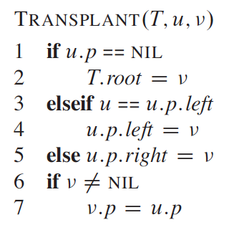
Binary Search Trees
Case (a - one right child)
Case (b - one left child)
Case c and d- find successor
case d: if successor is not direct child of z
Case (c)
3. Line 3 and 7
5. Line 1

Slide 24
Demo
[1, 4, 10, -1, 6, 8, 2]
- make a tree for me first
- then try to delete 4, 2, 6

Slide 25
Exercise
Insert <4, -4, 3, 5, 1, 4, 8, 6, 2, 5> .
Show the deletion of 3 and 5 (the top one) from the above binary tree.

Slide 26
Binary Search Trees
 | Running time in BigO
Access | O(h) or O(log N)
Linear search | O(h) or O(log N)
Min, Max | O(h) or O(log N)
Insertion | O(h) or O(log N)
Deletion | O(h) or O(log N)

Slide 27
Binary Search Trees: Performance
As you can see, the performance of BST depends on height.
What do you think is the best height and worst height?
The best height is when you have a perfectly balanced tree, each node having two child nodes -Θ(lg(n))
The worst height is when you get a linear tree (one node at one height) - O(n)
Thus latter in the class, we would need to learn different techniques to self-balance the tree → Red Black Trees, AVL Trees, 2-3-4 trees, treaps, etc.

Slide 28
Until now
Searching in arrays, linked list takes O(n)
We can even make our search faster by using sorted list + BST -> O(log n).
Do you think we can make this search performance even faster? Yes -> Hashing → Search performance of O(1)
Before that, let’s introduce the dictionary problem first

Slide 29
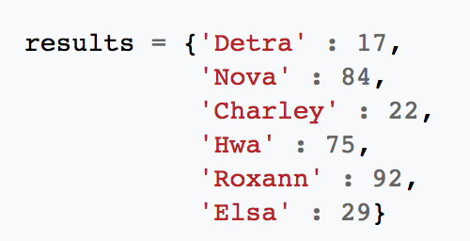
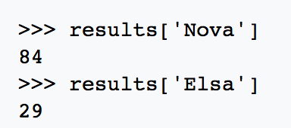
Dictionary problem
A dictionary problem is a abstract data type which aims to maintain a set of items, each with a key, subject to
insert(item), delete(item), and search(key) - which find item with that key
With that said, each key is associated with only one item
During insert, if the same key is inserted, it will override the old key
Typically, the keys in a dictionary must be simple types (such as integers or strings) while the values can be of any type.

Slide 30
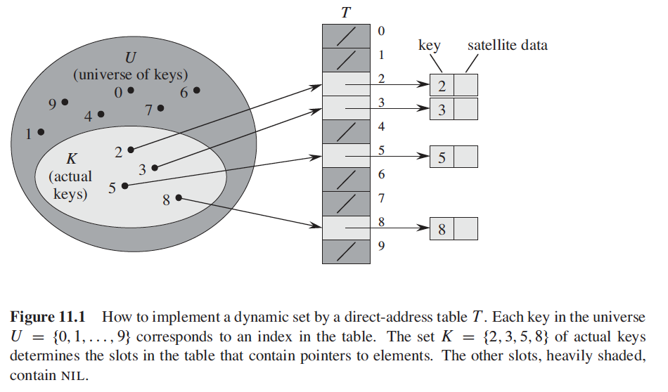
Solving the dictionary problem
Can we make search in dictionary faster? O(n) is just too slow? Direct address table is likely the first idea that comes to mind
lot of keys - waste a lot of space
Does not support non-negative keys or string keys

Slide 31
Solving the dictionary problem
Because it uses the index array as the key position, the key can only be non-negative integers.
Can be solved by prehash - mapping keys to nonnegative integers
But ideally we want prehash(x) = prehash(y) only when x = y
We need to make sure prehash always give the same value for the same key

Slide 32
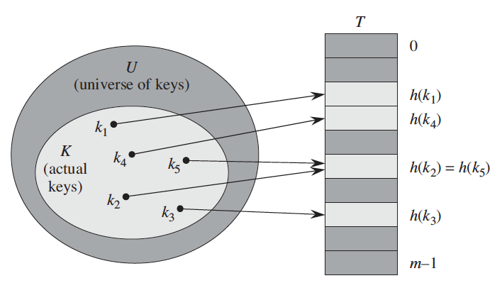

Solving the dictionary problem
Doing this way will require huge amount of space
Can be solved by hashing
Reduce universe of all keys (integers) down to a reasonable size m for table (m = Θ(n), i.e., size of the table to be proportional to the keys in the dictionary)
A hash function h . A hash function is a function which when given a key, generates an address in the table. h maps the universe U of keys into the slots of a hash table T[0..m-1] where the size m is typically much less than |U|
When two keys hash to the same index, we called “collision”

Slide 33

Hashing - Good hash functions
A good hash function satisfies the each key is equally likely to hash to any of the m slots, independently of where any other key has hashed to
Division method
Ex. Hash table size m = 12, and the key is 100, then h(k) is 4.
mod m wil give you a number between zero and m-1
This method usually yields good results but we usually avoid some values of m, i.e., when m has some common factors with k
In practice, you always choose prime table size so you don’t have those common factors
Your m is should NOT be very close to power of 2 or power of 10 because they have way too many common factors
A prime not too close to an exact power of 2 is a good choice. For example, n = 2000. We choose m = 701 because it is a prime near 2000/3 but not any near power of 2. We do not really mind searching an average of 3 elements in an unsuccessful search

Slide 34
Why prime number is used for hash?
If we use mod 4 we find:
10 mod 4 = 2
20 mod 4 = 0
30 mod 4 = 2
40 mod 4 = 0
50 mod 4 = 2
If we use a prime number 7:
10 mod 7 = 3
20 mod 7 = 6
30 mod 7 = 2
40 mod 7 = 4
50 mod 7 = 1
Prime number has a good property to induce randomness to our hash results. Thus prime number is commonly used as part of the hash function
Every key in 𝐾 that shares a common factor with the number of buckets 𝑚 m will be hashed to a bucket that is a multiple of this factor.

Slide 35
Demo
-keys = {1, 4, 10, 3, 9, 45, 99}
-m = 8
-Use the division method to construct the hash table
-if there is a collision, just simply put in the same bucket (i will teach you later….)

Slide 36
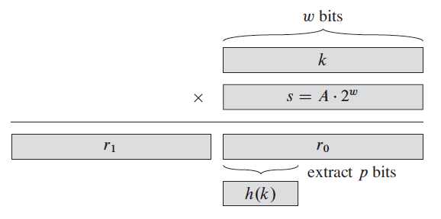


Hashing - Good hash functions
Multiply k with w-bit integer s, where s = A * 2^{w}. The result is r₁2^{w} + r₀. We take p bits of r₀
Multiplication method
First we multiply the key k by a constant A in the range 0 < A < 1 and extract the fractional part of kA
Then we multiply this value by m and take the floor of the result. Thus the hash function is
We typically choose m to be a power of 2 (m = 2^{p} for some integer p), since most computers works on binary. Ex. Suppose that the word size of the machine is w bits. We restrict A to be a fraction of the form s/2^{w}, where s is an integer in the range 0 < s < 2^{w}.
Knuth suggests that optimal constant A to be
Ex. k = 123456, p = 14, and m = 2¹⁴ = 16384 and w = 32. Following Knuth suggestions, we choose A to be fraction of the form s/2³² that is closest to (√5-1)/2, so that A = 2654435769/2³² Then k * s = 327706022297664 = (76300 * 2³²) + 17612864, and so r₁ = 76300 and r₀ = 17612864. 17612864 = 00000001 00001100 11000000 01000000 (binary). The top fourteen bits = 00000001 000011 = 67, thus the value h(k) = 67

Slide 37
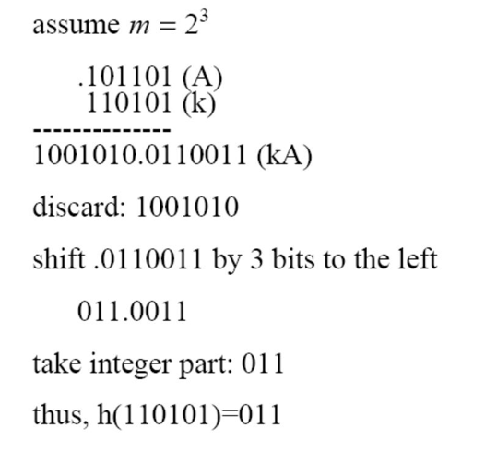
Hashing - Good hash functions

Slide 38
Demo
-keys = 43 ⇒ 101011
-m = 2³
- A = .110110
- key = 39 ⇒ 100111
- m = 2⁴
- A = .110101
⁻ kA = 0100000 0100 11

Slide 39

Hashing - Good hash functions
This strategy works well if multiplication by A does a good job of “scrambling” the bits of k. To ensure good scrambling, A should have a substantial number of 1 bits but should not exhibit a highly regular bit pattern; irrational values are best. Of course, A should also not be too small – very small values will map a lot of keys to low-numbered slots, especially slot 0. Knuth suggest
Other easily computable rational number is

Slide 40
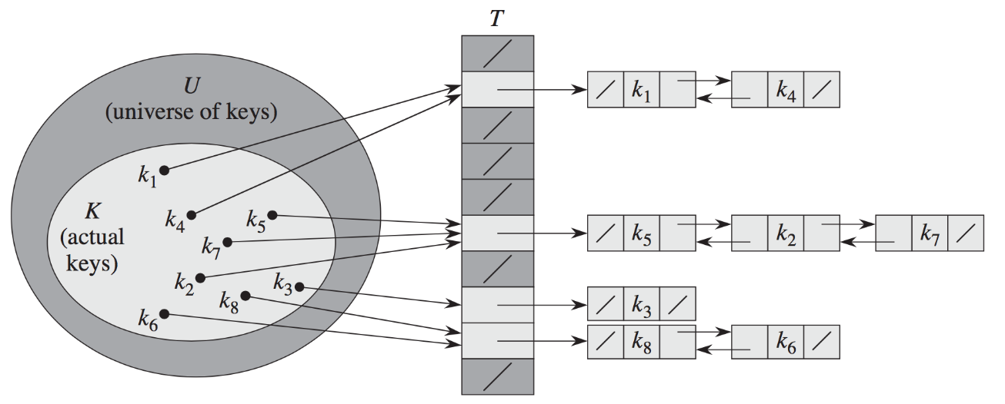
Hashing - Collision Resolution Methods
Chaining
Simply apply a linked list for each index
Worst case - O(N) for linear search
Best case - O(1) - happens more often if the hash table size is big
We can increase this chance by resizing of the hash table, e.g., double the size of the table when load factor exceeds a certain threshold, for example 0.75, where load factor (n/m) is number of entries in the hash tables (n) / capacity of the hash tables (m)
When m = Θ(n) then the search is likely Θ(1 + load factor)
assumes simple uniform hashing -> Pr {h(k1) = h(k2)} = 1/m

Slide 41
Hashing - Collision Resolution Methods
2. Open Addressing (works under the assumption that m >= n)
A concept based on probing, i.e., keep on searching until an empty slot is found
is define by h(k, i) where i defines the trials
Insert(k) - keep probing until an empty slot or a delete flag is found
Search(k) - while the slots encountered are occupied by keys not equal to k or occupied by a delete flag, keep probing until you encounter k or you find an empty slot. Since you are using the same deterministic sequence of probes in both insert(k) and delete(k), founding an empty slot would mean that k cannot be found
Delete(k) - deleting is a bit tricky, because once you delete it, it will become an empty slot, and that will “trick” search(k) that k is not found since it hits an empty slot first. Replacing “empty slot” with a flag such as “Just got deleted” can easily remedy this problem. And thus for insert(k), if you found this flag, you can insert at this position too. Same for search(k), if you found this flag, keep on searching.

Slide 42
Exercise
k = {12, 14, 3, 6, 9, 2, 11, 10, 4}
m = 11
insert
delete 3, 14, 12
search 11, 6, 99

Slide 43


Hashing - Collision Resolution Methods
2. Open Addressing (works under the assumption that m >= n)
Linear Probing - stores at next free space when there is collision; prone to clustering - consecutive groups of occupied slots which keep longer
Worst case - O(N) - if all keys are mapped to same index, we need to probe all elements
Best case - O(1)
Quadratic probing - avoid clustering of linear probing. Perform a squared skip instead of linear probing
More likely to hit an empty slot for insertion and searching, compared to linear probing
Commonly choose m to be prime > 2, , many choices of c will work such as c1 = c2 = 1/2, c1 = c2 = 1, and c1 = 0, c2 = 1

Slide 44

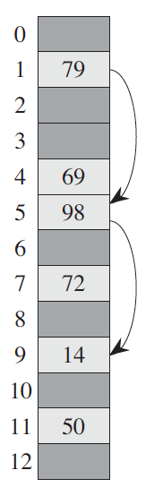

Hashing - Collision Resolution Methods
c. Double hashing - offers one of the best methods for open addressing because the permutations produces have many of the characteristics of randomly chosen permutations
To increase randomness,
let m be prime and design h₂ so that it
does not return 0
is not the same as first hash function
Ex. we could choose h₁(k) m prime, and h₂(k) to be 1 + something so it does not return 0, where h₂(k) m’ should be less than m so it is not quite the same as first hash function
Ex. Here we have a hash table m of size 13 with h1(k) = k mod 13 and h2(k) = 1 + (k mod 11). h1(14) = 1, h2(14) = 4. Thus, when i = 0, then h(k, 0) = 1, h(k, 1) = 5, h(k, 2) = 9. 9 is where the empty slot is found

Slide 45
Exercise
CLRS 11.4-1
Consider inserting the keys 10, 22, 31, 4, 15, 28, 17, 88, 59 into a hash table of length m = 11 using open addressing with hash function h’(k) = k. Illustrate the result of inserting these keys using
linear probing
quadratic probing with c_1 = 1, and c_2 = 3
double hashing with h1(k) = k and h2(k) = 1 + (k mod (m - 1))

Slide 46
Linear probing
keys 10, 22, 31, 4, 15, 28, 17, 88, 59 , m = 11

Slide 47
Quadratic probing
keys 10, 22, 31, 4, 15, 28, 17, 88, 59 , m = 11

Slide 48
Double hashing probing
keys 10, 22, 31, 4, 15, 28, 17, 88, 59 , m = 11

Slide 49
Hashing - Collision Resolution Methods
3. Universal hashing - using only one hash function is vulnerable to hacking.
Universal hashing is all about inducing randomness to the results, instead of just “assuming” (or hoping) that the input is random itself
Universal hashing is about choosing hash functions randomly from H (a set of possible hash functions)
Require H to be universal hash family: for all keys k ≠ k’, Pr {h(k) = h(k’)} ≤ 1/m (can read “at most 1/m”)
Different from simple uniform hashing where it assumes that keys are random, it assumes that the hash functions are random
h ∈ H

Slide 50
Hashing - Collision Resolution Methods
3. Universal hashing (cont.)
Bad universal hash family : set of all hash functions H = {all hash functions h: {0, 1, ….u-1} → {0, 1, …., m-1}. This is bad because it takes a lot of space - Θ(u). Putting the hash functions into U also takes Θ(u) time to compute. And u is way way bigger than n.
Good universal hash family: choose a prime number p large enough so that every possible k is in the range 0 to p-1. Let ℤ_{p} denote the set {0, 1, …, p-1}, and ℤ*_{p} be {1, 2, ...p-1}. Here we have p > m. We define the hash function h_{ab}(k) for a ∈ ℤ*_{p} and b ∈ ℤ_{p} to be
With p = 17, m = 6, a = 3, b = 4, and k = 8, h_{3, 4}(8) = 5
This function maps ℤ_{p} to ℤ_{m}
Since we have p - 1 choices for a, and p choices for b, the collection contains p(p-1) hash functions

Slide 51
Hashing - Collision Resolution Methods
4. Perfect hashing - assumes a static set of keys (i.e., no insert and delete). O(1) for search time, O(n) for worst case space complexity, and polynomial time building.
Uses two levels of hashing, with universal hashing at each level
Step 1: Pick h1 : {0, 1,...,u − 1}→{0, 1,...,m − 1} from a universal hash family for m = Θ(n) (e.g., nearby prime). Hash all items with chaining using h1.
Step 2: For each slot j ∈ {0, 1,...,m − 1}, let l_{j} be the number of items in slot j.
The second level used a hash table, one hash table S_{j} for each slot j, and distinct hash function h_{j} for each slot j. Pick h_{2,j} : {0, 1,...,u − 1}→{0, 1,...,mj} from a universal hash family for l_{j}² ≤ m_{j} ≤ O(l_{j}²) (e.g., nearby prime)
To keep the space complexity to be O(n), we do this
If , then we redo step 1 (i.e., we need to compute everything again)
If two keys hash to the same position for the h₂, repick h₂ and rehash the whole hash table of that slot j

Slide 52
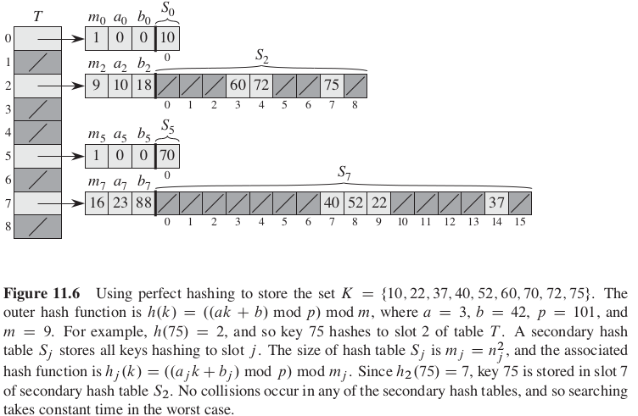
Hashing - Collision Resolution Methods

Slide 53
Assignment
Implement binary tree

